Slide 1














Patient survival prediction for cases admission
[CMPS451- Data Mining,Big Data and Data Analytics]
Team Members :
Yasmin Hashem Niazy 4200014
Sohad Hossam ELdin 1190019
Bassant Hisham 1190018
Yasmin Zaki Bassiouny1190352

Slide 2

4.Data-Driven Decisions: Machine learning enables data-driven decision-making, tailoring treatment plans based on individual patient risk profiles.
Enhanced Patient Care: Accurate prediction of patient survival upon admission allows for timely interventions, improving patient outcomes and satisfaction.
2.Resource Efficiency: Predictive models optimize resource allocation, including staffing and equipment, leading to cost savings and better resource utilization.
Business Benifit
5.Research and Innovation: The project fosters research and innovation in healthcare analytics, advancing predictive modeling for improved patient outcomes.
Exploring creativity
3.Cost Reduction: Early identification of high-risk patients reduces healthcare costs by preventing adverse events and shortening hospital stays.
6.Competitive Advantage: Organizations using predictive analytics gain a competitive edge by offering high-quality, data-driven healthcare services.

Slide 3
01. Data Preprocessing
Technical Part
02. EDA and Data Visiualziation
03.Feature Engineering and Models Predection

Slide 4
01. Data Preprocessing
Data Cleaning
01
02
03
04
05
Removing missing data/ N/A / unexpected values
dealing with outliers
data normalization/standardization
transform features to categorial if needed
visualizing the data using plots(box/scatter/histograms ...etc)

Slide 5

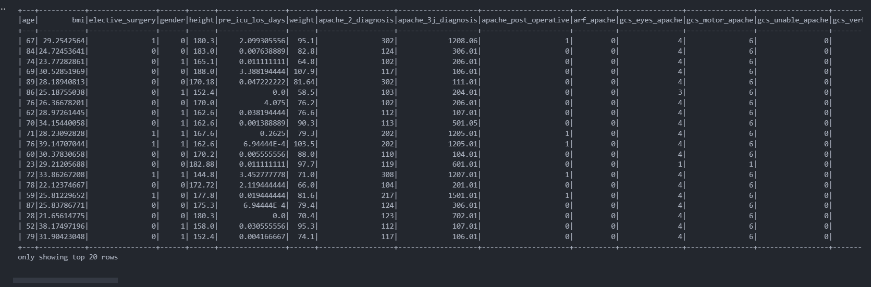
01. Data Preprocessing
Implementation
preprocess_map
preprocess_reduce
my_map
my_reduce

Slide 6
02.Data Visiualization
01
02
03
Box Plots
Pie Charts
Histograms

Slide 7
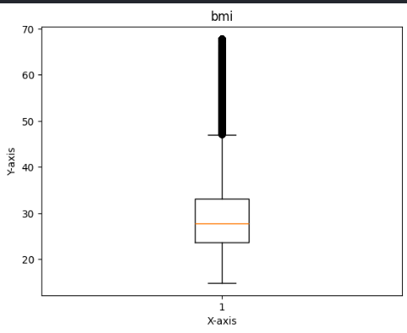
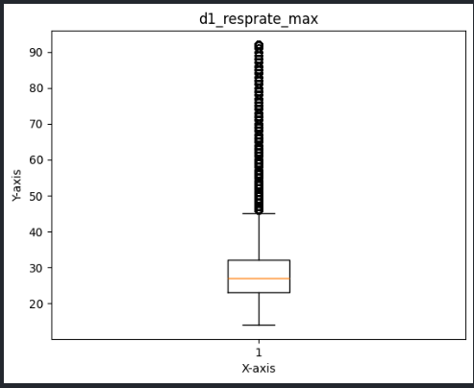
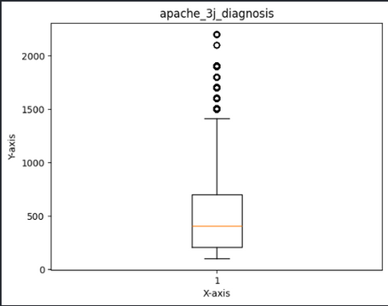
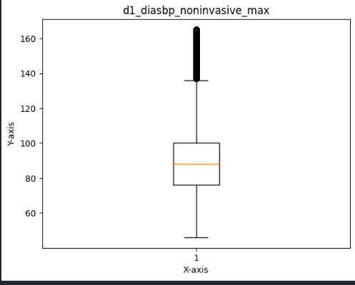
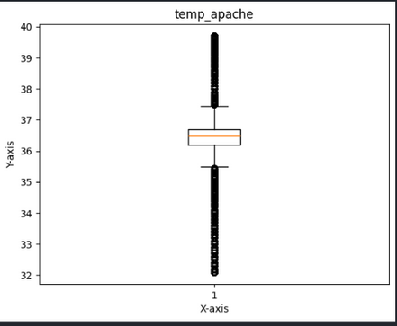
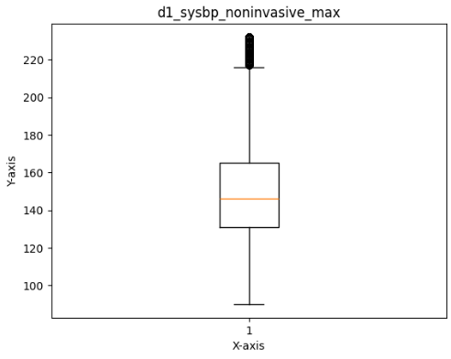
01
Box Plots

Slide 8
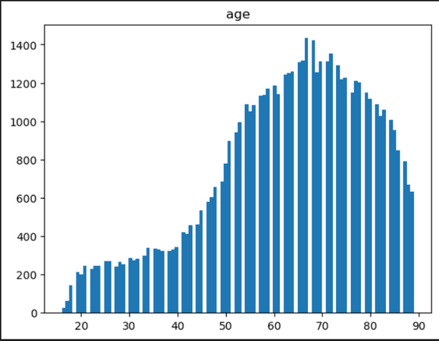
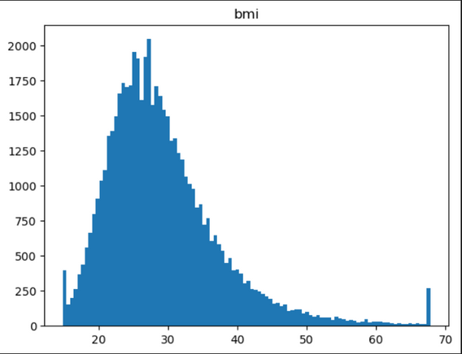
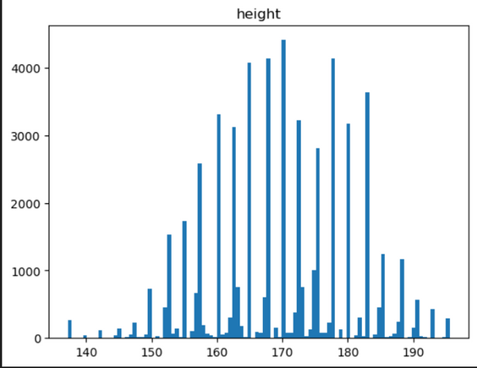
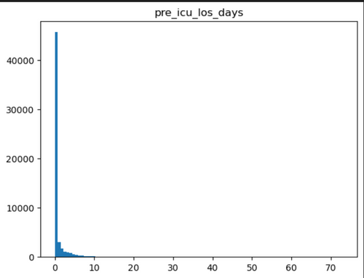
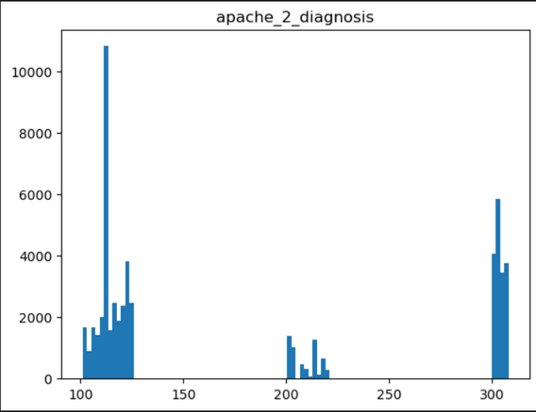
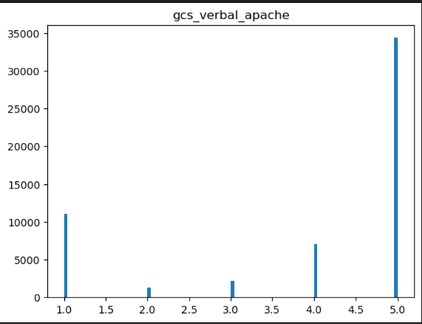
03
Histograms

Slide 9
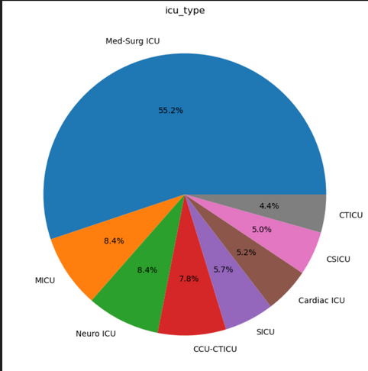
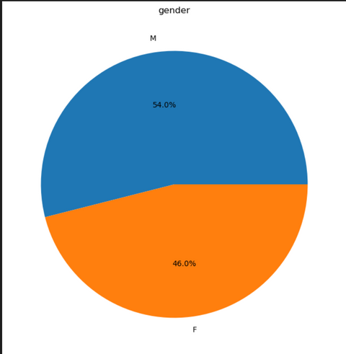
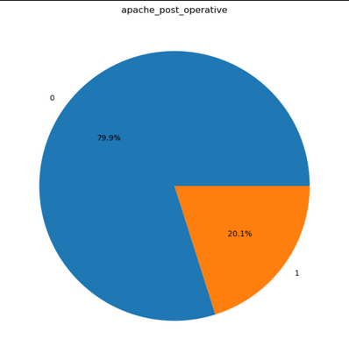
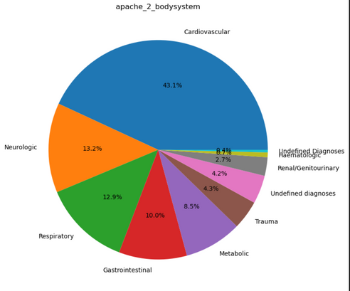
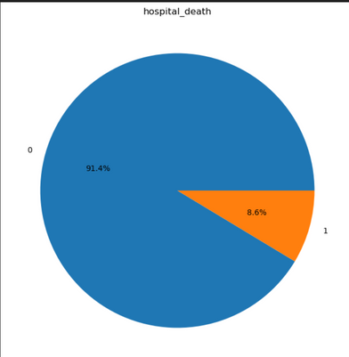
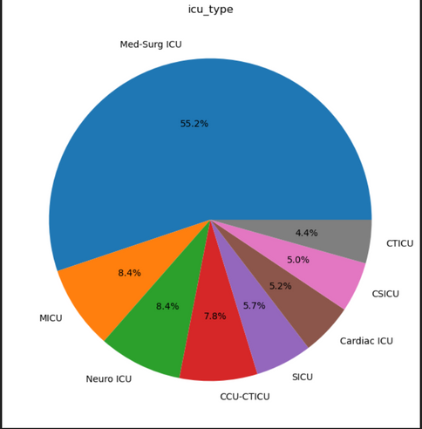
02
Pie Charts

Slide 10
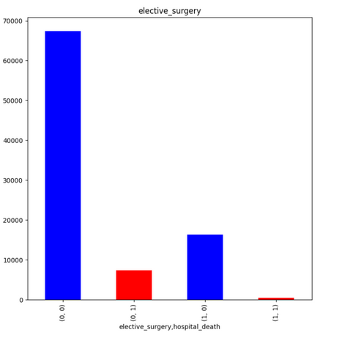
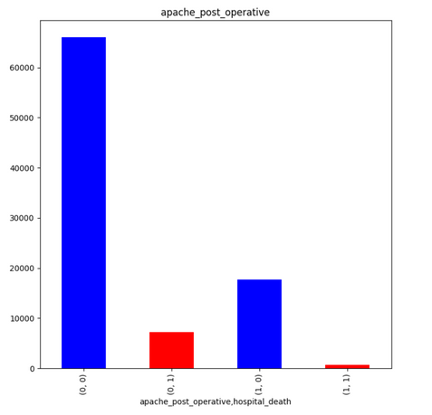
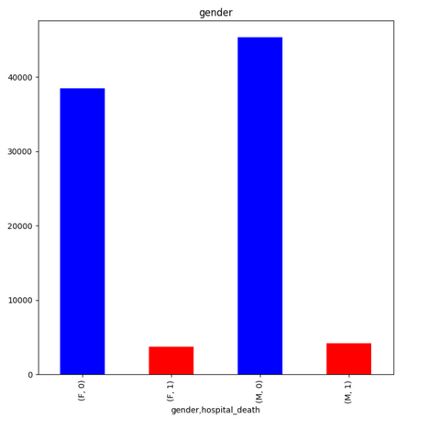
03
Bar Charts

Slide 11
03.1. my_map Function
03.4. reduce_func Function
03.Model Training and Predections Visiualization
03.2. map_func Function
03.5. Classifiers and Dataset Partitioning
03.3. my_reduce Function
03.6. Evaluation and Visualization

Slide 12
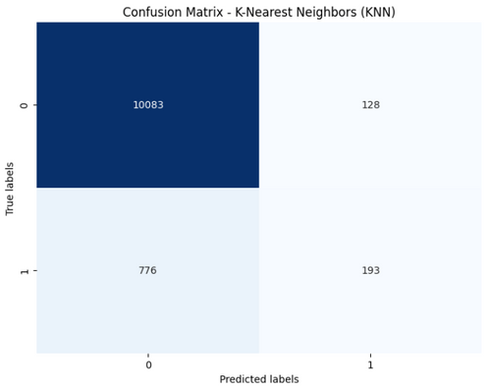
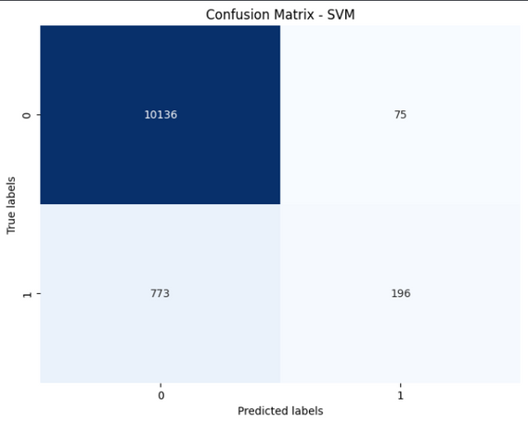
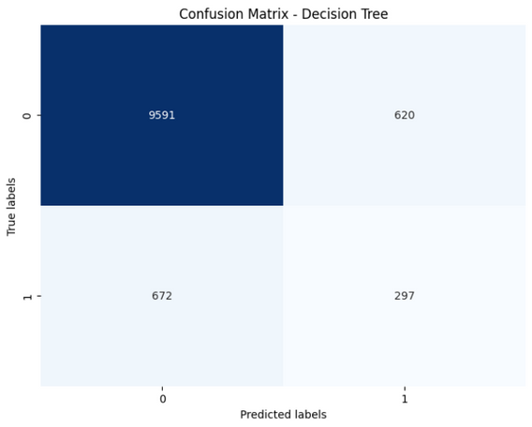
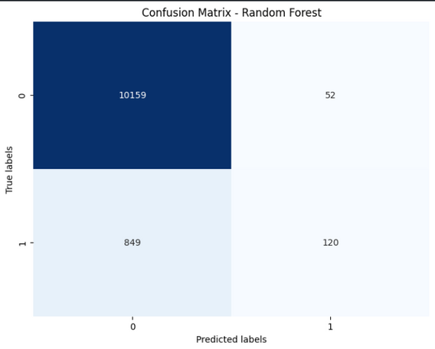


03.Models Confusion Matrics

Slide 13
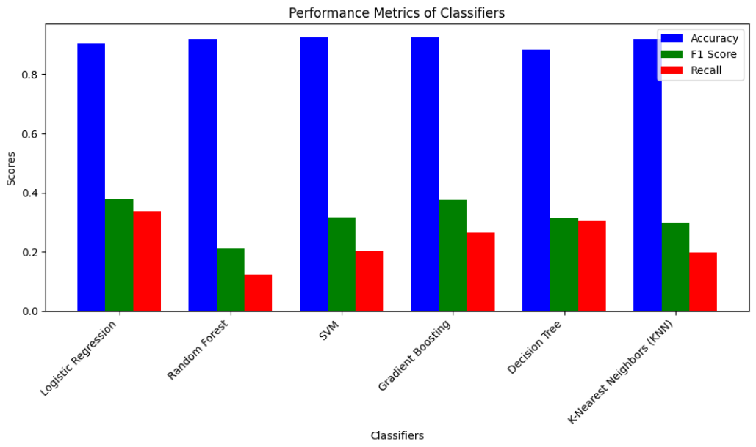
Preformance Metrics

Slide 14
Thank you very much!

